Slide 1
An In-Depth Exploration of Convolutional Neural Networks in Identifying Fake Imagery
Done By:
First Author: Dr.R.Arthy
Second Author: Sandeep Joe A Third Author: Kabilesh K Fourth Author: Vignesh V.K Fifth Author: Sriathesh S

Slide 2
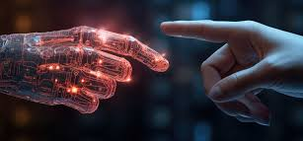
Project analysis slide 2
OVERVIEW
Abstract
Introduction
Objective
Problem statement
Literature survey
Proposed architecture
List of modules
Performance metrics
Performance analyses
Result & Discussion
Conclusion
Reference

Slide 3
Project analysis slide 3
ABSTRACT
The rapid advancement of artificial intelligence (AI) in generating realistic images has raised concerns about identifying synthetic imagery.
Sophisticated algorithms like Generative Adversarial Networks (GANs) are at the forefront, emphasizing the need for robust methodologies to preserve visual content authenticity.
Convolutional Neural Networks (CNNs) are identified as promising tools for distinguishing between AI-generated and genuine images.
The proposed system encompasses a wide research landscape, including CNN utility, deep learning advancements, and image generation techniques.
Methodologies employing CNNs augmented by activation functions like ReLU, Softmax, Sigmoid, and Linear are explained for discerning AI-generated images.
The proposed system achieves a 95% accuracy rate in AI image detection.
Experimental setups, challenges faced, and future research directions are elucidated, emphasizing the need for continuous innovation and interdisciplinary collaboration to safeguard digital imagery integrity amidst evolving AI capabilities.

Slide 4
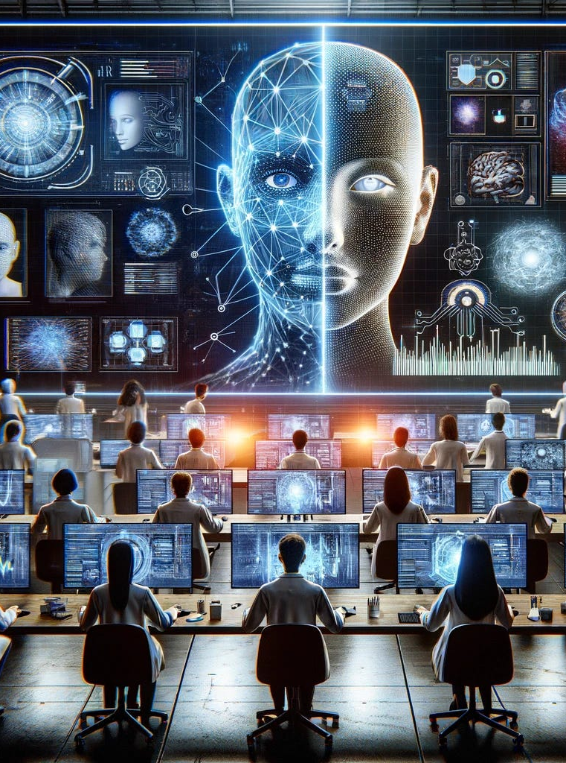
Project analysis slide 4
INTRODUCTION
The rise of artificial intelligence (AI) technology presents challenges in verifying the authenticity of visual content.
Convolutional Neural Networks (CNNs) are crucial tools for analyzing vast amounts of visual data.
This paper explores CNNs' role in identifying fake imagery, focusing on their architecture, functionality, and effectiveness.
The study aims to highlight advancements, challenges, and implications of using CNNs to safeguard visual content integrity.
CNNs offer promise in discerning between genuine and AI-generated images, given their ability to process complex visual data accurately.

Slide 5
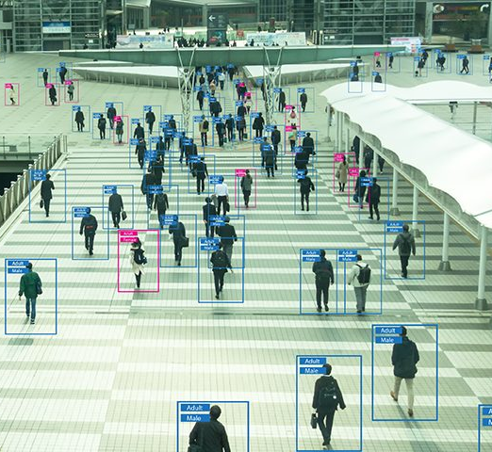
Project analysis slide 6
OBJECTIVE
The primary objective of AI image detection is to identify fake images and prevent illegal activities such as face morphing, creating duplicate images to fabricate false evidence, and other forms of digital manipulation.
Analyze experimental setups and methodologies employed in CNN-based fake imagery detection, including dataset selection, training procedures, and evaluation metrics.
Identify challenges and limitations associated with CNN-based approaches in identifying fake imagery and propose potential solutions or areas for future research.

Slide 6
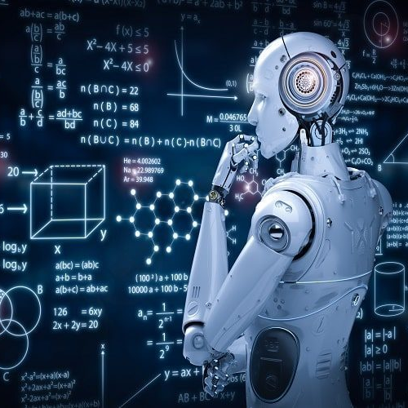
Project analysis slide 7
PROBLEM STATEMENT
Deep learning advancements, especially in image generation, complicate the differentiation between synthetic and authentic visuals.
This complexity has profound implications for digital forensics, media integrity, and online information reliability.
The emergence of AI-generated images emphasizes the critical need for robust methods to discern between AI-created and human-captured visuals.
Ensuring the trustworthiness of digital content requires addressing the challenge of distinguishing between fake and real visual content.
The presentation aims to investigate the nuances of this challenge, exploring methods for differentiation.
Convolutional Neural Networks (CNNs) and other advanced techniques play a pivotal role in meeting the demand for reliable visual content authentication.

Slide 7
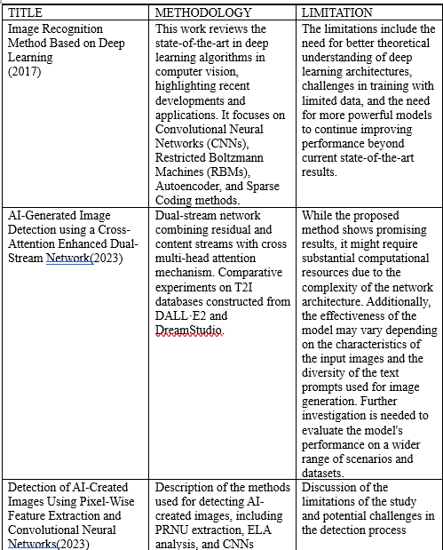
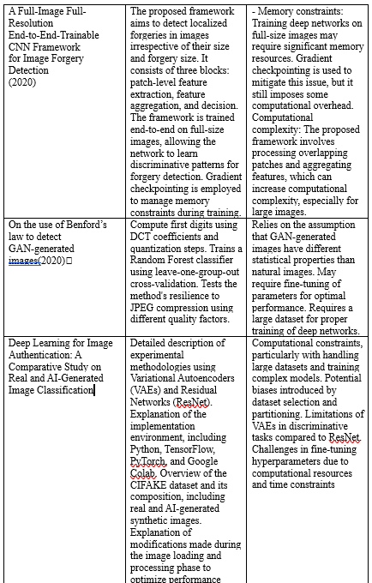
Project analysis slide 11
LITERATURE SURVEY

Slide 8
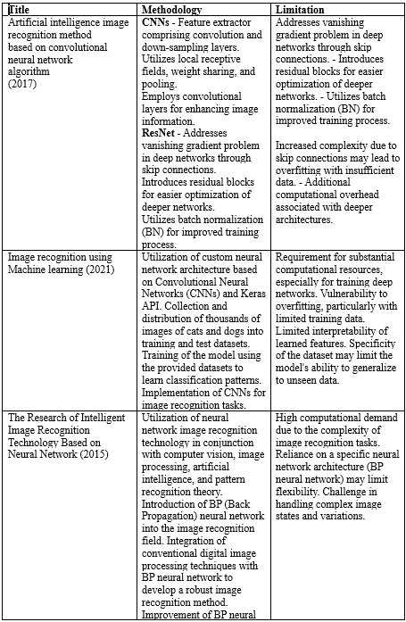
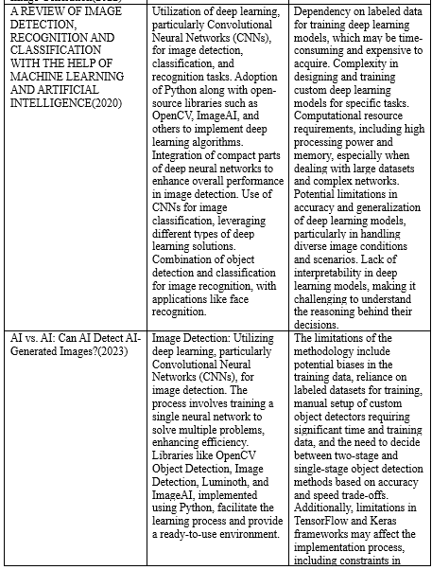
Project analysis slide 11
LITERATURE SURVEY

Slide 9
Project analysis slide 8
PROPOSED ARHITECTURE
Our proposed architecture for AI-generated image detection leverages Convolutional Neural Networks (CNNs) as the core technology, enhanced by advanced methodologies. It consists of:
Data Preprocessing: Raw image data is normalized, scaled, and encoded to prepare for model input.
Feature Extraction: CNNs extract features from preprocessed data, capturing complex patterns.
Activation Functions: ReLU, Softmax, Sigmoid, and Linear functions aid in feature extraction and decision-making.
Training and Testing: The model is trained and tested on datasets containing synthetic and authentic images.
Decoding and Evaluation: Output probabilities are decoded for performance evaluation using metrics like accuracy, precision, and recall.
Future Directions: Sets the groundwork for future research, including novel CNN architectures and advanced learning techniques, to improve detection accuracy.
This architecture aims to enhance AI-driven image detection systems, crucial for maintaining the integrity of digital content amidst increasing challenges of distinguishing between synthetic and authentic visuals.

Slide 10
Project analysis slide 10
LIST OF MODULES
1. Data Preprocessing:
Deep learning serves as the cornerstone technology for image detection, leveraging its ability to autonomously learn hierarchical representations from raw data. The survey underscores the significance of deep learning frameworks like OpenCV Object Detection, Image Detection, Luminoth, and ImageAI, which streamline the implementation of complex image detection models.
2. Feature Extraction:
Recent progress in CNN research has resulted in significant breakthroughs, greatly enhancing the network's capabilities in image recognition tasks. The integration of recurrent neural networks (RNNs) with CNNs has ushered in a new era of advancements, enabling the simultaneous assimilation of deep image features and temporal dependencies inherent in image data.
3. Activation Functions:
Activation functions play a crucial role in the CNN architecture, facilitating different aspects of neural network learning and decision-making. The significance and mathematical underpinnings of ReLU, Softmax, Sigmoid, and Linear activation functions serve unique purposes within the CNN framework.

Slide 11
LIST OF MODULES
4. Training and Testing:
Utilizing CNN for AI-Generated Image Detection involves training the model with extensive datasets containing both synthetic and real images. The objective is to enable these models to perceive the nuanced distinctions between the two kinds of visuals.
5. Decoding and Evaluation:
The experimental framework involves evaluating the model's proficiency in identifying AI-generated images through metrics such as accuracy, precision, and recall. This includes decoding the model's outputs and assessing its performance on test datasets.
6. Future Directions:
The literature survey provides insights into future research directions, including exploring novel CNN architectures, broadening dataset diversity, and integrating methodologies like transfer and unsupervised learning to enhance detection accuracy.

Slide 12
Project analysis slide 2
PERFORMANCE METRICS
SoftMax Model:
Accuracy Rate: 95%
Demonstrated superior performance in handling multiple classes and outputting a probability distribution.
Sigmoid Model:
Accuracy Rate: 94%
Achieved notable accuracy in generating probabilities between 0 and 1, slightly less effective than SoftMax.
Linear Model:
Accuracy Rate: 8%
Underperformed significantly, highlighting challenges of applying linear approaches to complex classification tasks.
ReLu Model:
Accuracy Rate: 50%
Achieved moderate accuracy with a non-linear activation function, outperforming the Linear model but not reaching the efficacy of SoftMax and Sigmoid models.

Slide 13
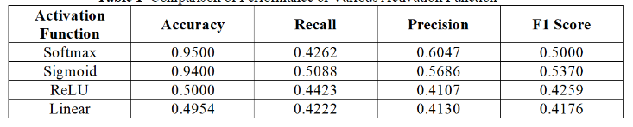
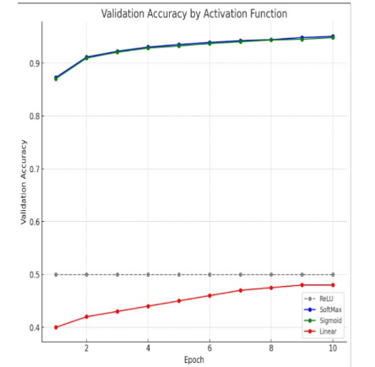
Project analysis slide 5
PERFORMANCE ANALYSIS

Slide 14
Project analysis slide 2
RESULTS & DISCUSSION
Investigation focused on distinguishing AI-generated images with a dataset of 50,000 examples per category.
Four neural network models were evaluated: SoftMax, Sigmoid, Linear, and ReLu.
SoftMax achieved the highest accuracy at 95%, showcasing its adeptness in handling multiple classes.
Sigmoid followed closely with 94% accuracy, indicating its effectiveness in generating probabilities between 0 and1.
Linear model severely underperformed with only 49% accuracy, revealing the challenges of linear approaches for complex classification tasks.
ReLu model achieved a moderate 50% accuracy, outperforming Linear but falling short of SoftMax and Sigmoid.
SoftMax's dominance emphasized the critical role of model selection in AI tasks.
Future research opportunities include exploring advanced neural networks and expanding the dataset.
The project deepened understanding in AI image detection, emphasizing the importance of preprocessing, model architecture, and task specificity.

Slide 15

Project analysis slide 2
CONCLUSION
Summarize the key findings and their significance in the broader context of AI and digital authenticity.
Reflection on the need for continuous innovation in detection methods to keep pace with AI advancements.
“The true art of AI image detection lies not just in differentiating the real from the synthetic, but in understanding the creativity of the machine mind”

Slide 16
Project analysis slide 2
REFERENCES
Tian, Y., (2020) Artificial Intelligence Image Recognition Method Based on Convolutional Neural Network Algorithm. IEEE Access. https://doi.org/10.1109/access.2020.3006097
Patil, Abhinav, (2021) Image Recognition using Machine Learning, Available at SSRN: https://ssrn.com/abstract=3835625 http://dx.doi.org/10.2139/ssrn.3835625
Bird, J.J., Lotfi, A., (2024) CIFAKE: Image Classification and Explainable Identification of AI-Generated Synthetic Images. IEEE Access. https://doi.org/10.1109/access.2024.3356122
Elasri, M., Elharrouss, O., Al-Maadeed, S., Tairi, H., (2022) Image Generation: A Review. Neural Process Lett. https://doi.org/10.1007/s11063-022-10777-x
Kumari, R., Nikki, S., Beg, R., Ranjan, S., Gope, S.K., Mallick, R.R., Dutta, A., (2020) A Review of Image Detection, Recognition and Classification with the Help of Machine Learning and Artificial Intelligence. SSRN Journal. https://doi.org/10.2139/ssrn.3611339
Baraheem, S.S., Nguyen, T.V., (2023). AI vs. AI: Can AI Detect AI-Generated Images? J. Imaging. https://doi.org/10.3390/jimaging9100199
Zhong, N., Xu, Y., Qian, Z., Zhang, X., (2023). Rich and Poor Texture Contrast: A Simple yet Effective Approach for AI-generated Image Detection. https://doi.org/10.48550/ARXIV.2311.12397

Slide 17
Project analysis slide 2
REFERENCES
Mingjian Zhu, Hanting Chen, Qiangyu YAN, Xudong Huang, Guanyu Lin, Wei Li, Zhijun Tu, Hailin Hu, Jie Hu, Yunhe Wang
Jia, X., 2017. Image recognition method based on deep learning. 2017 29th Chinese Control And Decision Conference (CCDC) https://doi.org/10.1109/ccdc.2017.7979332
Xi, Z., Huang, W., Wei, K., Luo, W., Zheng, P., (2023). AI-Generated Image Detection using a Cross-Attention Enhanced Dual-Stream Network. https://doi.org/10.48550/ARXIV.2306.07005
Martin-Rodriguez, F., Garcia-Mojon, R., Fernandez-Barciela, M., (2023). Detection of AI-Created Images Using Pixel-Wise Feature Extraction and Convolutional Neural Networks. Sensors. https://doi.org/10.3390/s23229037
Marra F, Gragnaniello D, Verdoliva L, Poggi G (2020) A full-image full resolution end-toend-trainable CNN framework for image forgery detection, IEEE Access
Bonettini N, Bestagini P, Milani S, Tubaro S (2020) On the use of Benford’s law to detect GAN-generated images. IEEE international conference on pattern recognition
Gragnaniello D, Cozzolino D, Marra F, PoggiG(2021)Verdoliva L (2021) Are GAN generated images easy to detect? IEEE international conference on multimedia and expo (ICME), A critical analysis of the state-of-the-art.

Slide 18
Project analysis slide 2
REFERENCES
15. Baraheem, S.S.; Le, T.-N.; Nguyen, T.V. (2023), Image synthesis: A review of methods, datasets, evaluation metrics, and future outlook. Artif. Intell. Rev., 56, 10813–10865
16. Ye, H.; Yang, X.; Takac, M.; Sunderraman, R.; Ji, S (2021). Improving text-to image synthesis using contrastive learning. arXiv, arXiv:2107.02423

Slide 19
Thank You

